Slide 1
Regression Models
Week 1
Sohini Roychowdhury

Slide 2

Example of Regression Problems: UCI MLRepository [1]
-Predict Housing prices in your area.
-Predict Automotive Sales per region.
-Predict credit risk etc.
Dependent Variable : Y
Independent Variables: X={x₁,x₂,x₃….}
$\hat{y}=θ_{1}x_{1}+θ_{2}x_{2}$+ $θ_{3}x_{3…}$
[1] UCI ML Repository: https://bit.ly/34ReX0A

Slide 3
Linear Regression
Gradient Descent
Normal Equations

Slide 4
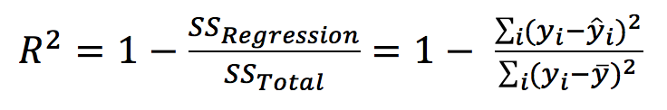
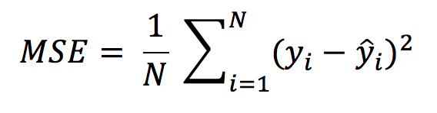
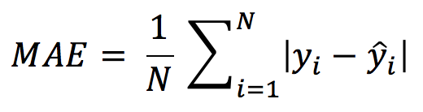
Output Metrics
Given for N samples
R Square/Adjusted R Square (Higher better)
Measures how much of variability in dependent variable can be explained by the model. Squared correlation coefficient.
Mean Square Error(MSE)/Root Mean Square Error(RMSE) (Lower better)
Measures goodness of model fit.
Mean Absolute Error(MAE) (Lower Better)
Measure of Absolute error in model fit.
MSE gives larger penalization to big prediction error by squaring it while MAE treats all errors the same.

Slide 5
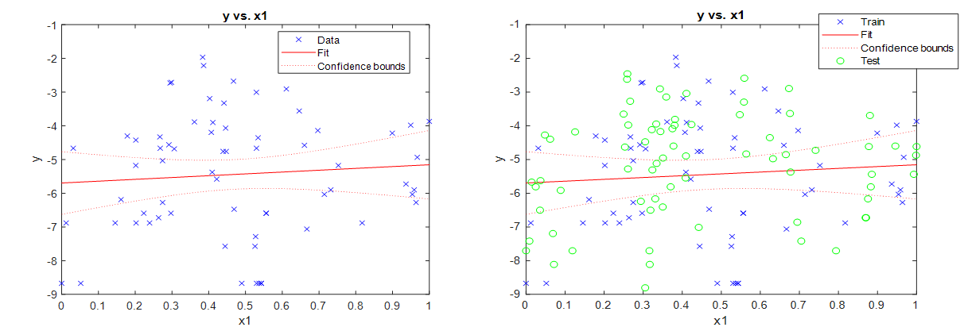
Model Fitting: In Practise
Split data to Train/Validation/Test (60/10/30% or 70/10/20%).
Pick an “Output metric”
Model Estimation Steps:
Build Model on Train Data
Evaluate Output metric on Validation Data
Continue (i) and (ii) till best Output Metric is achieved. Fix Model.
Report Output Metric from Fixed Model on Test Data.

Slide 6
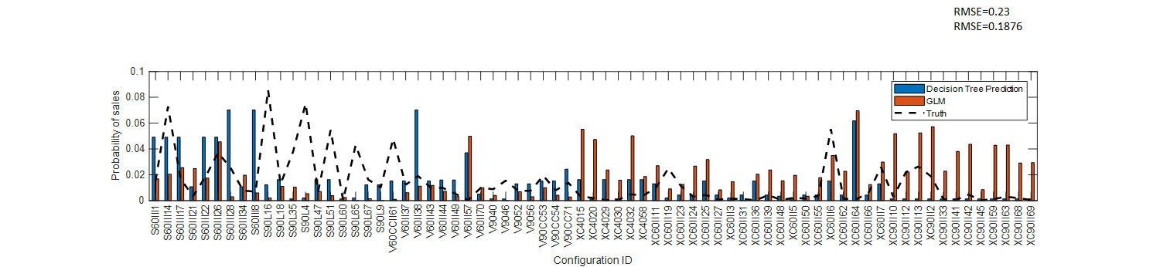
Examples of Regression Predictions
Under-Predictions
1 2 3 4 5 6 7 8 9 10 1112 13 14 15 16 17 18 19 20 21 22 23 24 25 26 27 28 29 30 31 32 33 34 35 36 37 38 39 40 41 42 43 44 45 46 47 48 49 50 51 52 53 54 55 56 57 58 59 60 61 62 63 64 65 66 67 68 68 69 70 71 72 73 74 75
Cosmetic Product ID
Over-Predictions
Under/Over Predictions mostly caused by differences in training and test data distributions.

Slide 7
Generalized Linear Models

Slide 8

Generalized Linear Models (GLM)
General class of linear models that are made up of 3 components: Random, Systematic, and Link Function
Random component: Identifies dependent variable (Y) and its probability distribution.
For Linear Regression: Gaussian distribution
For classification (Logistic Regression): Bernoulli distribution (p), p=probability of event.
Systematic Component: Identifies the set of explanatory variables (X₁,...,X_{k})
Link Function: Identifies a function of the mean that is a linear function of the explanatory variables. It explains how the expected value of the response relates to the explanatory variables. Examples:
Identity Link, for linear regression, η = E(Y_{i})=g(μ)= μ
Log link, when mean cannot be negative in Poisson distributions, η = log(μ)
Logit link, when mean is bounded in [0,1] for logistic regression (classification)

Slide 9

GLM Estimation
Mathematical Formulation
Given samples {x,y}, the probability density function follows the distribution:
-Where, is natural parameter, is dispersion parameter, and a,b,c are functions.
-For a normal case, ,
For regression
Thus, is estimated by Iteratively reweighted least squares solutions for maximum likelihood estimations. See https://bit.ly/2GcofK5

